Slide 1

Prometheus Demo
- Sunny Rohilla

Slide 2
Contents
Continuous Monitoring Concept
Prometheus Architecture and Features
Installation and
Configuration
Monitor your environment using Prometheus
Dashboard Visualization using Grafana

Slide 3
Continuous monitoring concept
Better Network Visibility & Transparency
Facilitates Rapid Responses
Minimizes System Downtime
Assist with Healthy Business Performance

Slide 4
Prometheus
It is a community driven open-source monitoring framework.
Has a robust alert mechanism.
A Cloud Native Computing Foundation (CNCF) graduated project.

Slide 5
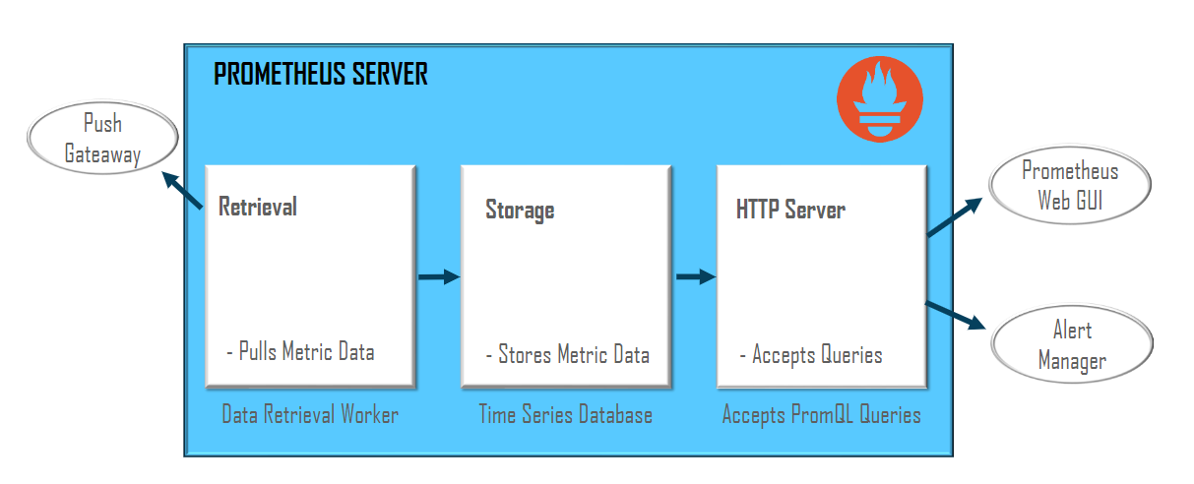
Prometheus ARCHITECTURE

Slide 6
Prometheus: Features
Dimensional Data
Uses a dimensional data model where series are identified by a metric name and a set of key-value pair
Simple Operations
Servers running Prometheus are independent of each other of reliability. Since it is written in Go-lang, the binaries can be easily updated.
Alert System
All the alerts are managed by an alert manager. The alerts are defined using the Prometheus's own PromQL.
Library Support
With support of over ten different languages, creating and implementing custom libraries is very easy.
Efficient Storage
Prometheus stores all the monitoring data on the local disk itself in an efficient custom format.
Visualization
Offers various options to visualize the monitoring data. The built-in expression browser can be integrated with tools such as Grafana.

Slide 7
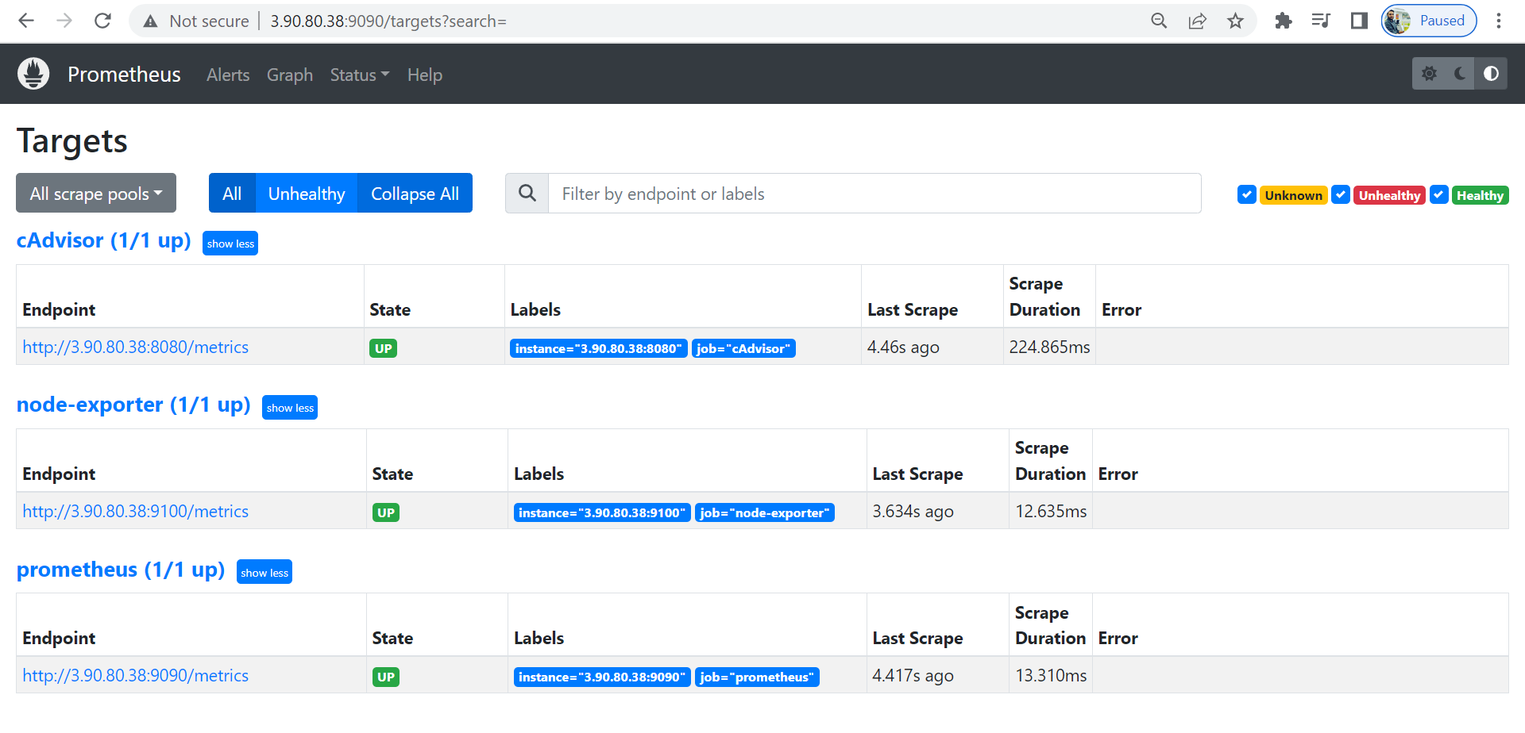
Prometheus – installation and configuration

Slide 8
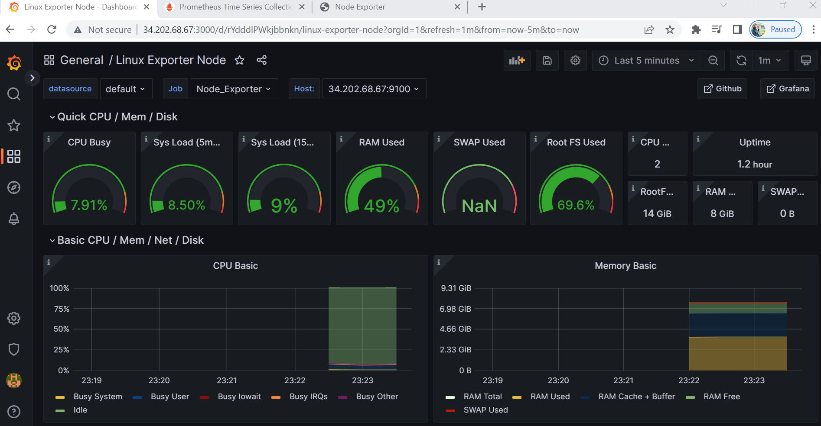
Grafana dashboard

Slide 9
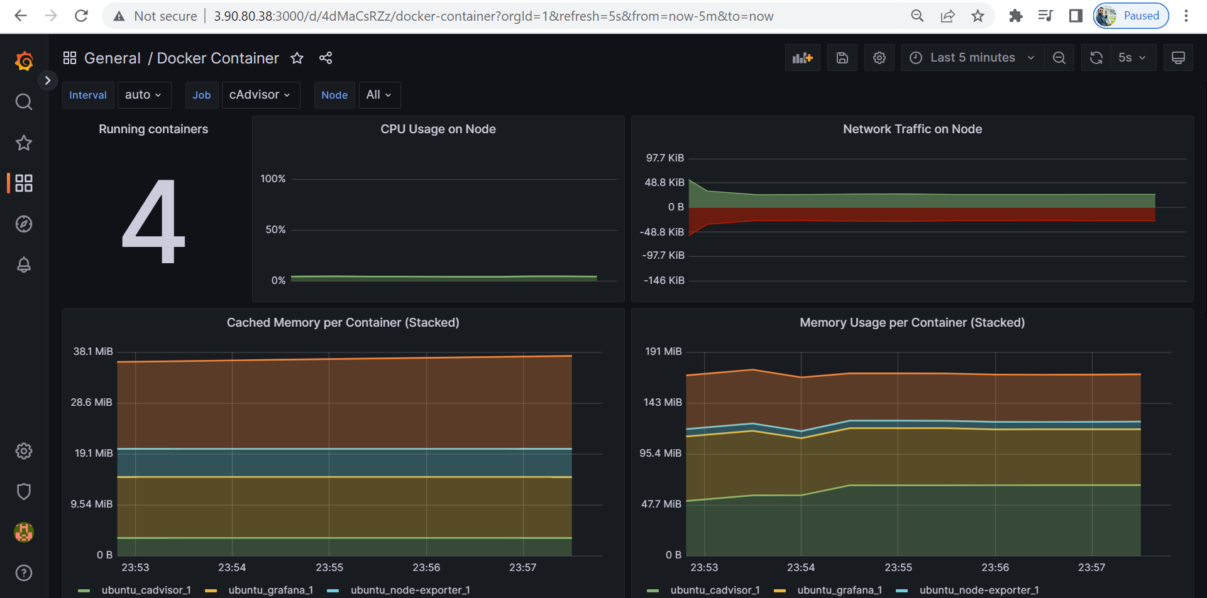
Grafana dashboard

Slide 10
Objectives
Install and configure Prometheus
Collect windows or Linux metrics using node exporter
Collect Docker metrics using the cadvisor exporter
Setup Grafana and plot all important KPIs
My GitHub Repo https://github.com/sunnyr22ops/prometheus_nodeexporter_grafana_CAdvisor

Slide 11

Thank you

